Slide 1
Developing for the Mobile Web
IN172 Web 3

Slide 2
Issues and Options
Is there really such a thing as the “mobile web”?
The whole notion that web developers need to accommodate people browsing on tablets and cell phones is really only a few years old.
While there are various quibbles over minor issues, the real schism comes down to the question of whether or not this “mobile web” thing even exists.
That is: are the web sites that are to be accessed via phone and tablet qualitatively different from those accessed by browsers, or is there just “one web” that needs to be accessible from devices spanning a wide variety of sizes and capabilities.
The optimal development techniques for these two positions are very different, which leads to these arguments about “how to do web development”

Slide 3
The Mobile Web is Different
“Good mobile user experience requires a different design than what's needed to satisfy desktop users. Two designs, two sites, and cross-linking to make it all work.”
Jakob Nielsen, April 2012
…” cut features, to eliminate things that are not core to the mobile use case; cut content, to reduce word count.”
Ibid.

Slide 4
The Mobile Web is Different
Basically, the previous quote argues that you shouldn’t build one website for, say, your restaurant, and expect people to browse it from the desktop or their phone (even assuming you use the various techniques available to make it usable on the phone)
This is because the use cases of mobile and desktop are different People on mobile devices are generally away from home, on the move, in the middle of something, looking to perform some task People on desktop are sitting in the their lounges.
So, for your restaurant, the mobile and non-mobile users want to do different things. A desktop user might be strolling through menus from many local restaurants trying to pick out a place for a special occasion dinner; the mobile guy want to directions because he’s late for his dinner date.
The same site can NOT be optimal for both these use cases.
In recognition of the physical limitation of mobile devices (reduced screen size, resolution and bandwidth) Nielson suggests not only restructuring the content of your site into different html/css chunks, but also slicing back the content

Slide 5
The Mobile Web is Different
…”if all you want to do is make sure that your site works on a few high end mobile devices, and you don't care particularly about catering for the mobile web user [use one site for both desktop and mobile].
If, on the other hand, you want to deliver a full designed-for-mobile experience [make separate sites]. There is a reason why essentially all of the top internet brands use this approach.”*
Ronan Cremin (mobiforge)
*Cremin is referring here to Google, Facebook, Amazon, Youtube, Ebay and Yahoo, all of whom have separate sites for mobile and desktop

Slide 6
There is Only One Web
[After discussing a case study where serving a reduced site upset a bunch of people]…The vital point is that you never know better than your users what content they want. When Nielsen writes that mobile websites should “cut features…cut content, he forgets this fact.
Bruce Lawson, April 2012
I believe that building special mobile websites is like sticking plaster over the problem; we generally shouldn’t have separate mobile websites, anymore than we should have separate screen reader websites. The reason many “full websites” are unusable on mobile phones is because many full websites are unusable on any device.
Ibid.

Slide 7
There is Only One Web
“Whether you’re talking about content or code, what you want to guard against is creating multiple versions of your website. It’s called forking, and it’s a forking nightmare from a maintenance perspective.”
Karen McGrane, May 2012
“Quit thinking you can just guess what subset of content a “mobile user” wants. You’re going to guess wrong.”
Ibid.
“Cutting content…treats mobile-only users as second class web citizens.”
Ibid.

Slide 8
There is Only One Web
These opinions maintain that “reducing content” penalises the mobile user and having multiple versions of your site makes it costly to build and difficult to maintain
This camp also points out that the whole “everybody’s got a desktop” and “everybody’s got an iPhone” are extremely westernised viewpoints.
In many developing parts of the world, the majority of people who have access to the internet only have access over mobile.
And they’re not using iPhones and Safari, they’re using feature phones and Opera Mini.
They say that, using some new development methodologies – particularly some new features of CSS3, you can write one html/css/js code base that can serve all users now and into the future

Slide 9
Summary
Separate Sites | One site
Fine tuned for performance Fine tuned for use cases Optimized for mobile extended capabilities like geolocation | Equal content access for all Reduced maintenance burden When done well, forces lean content design

Slide 10
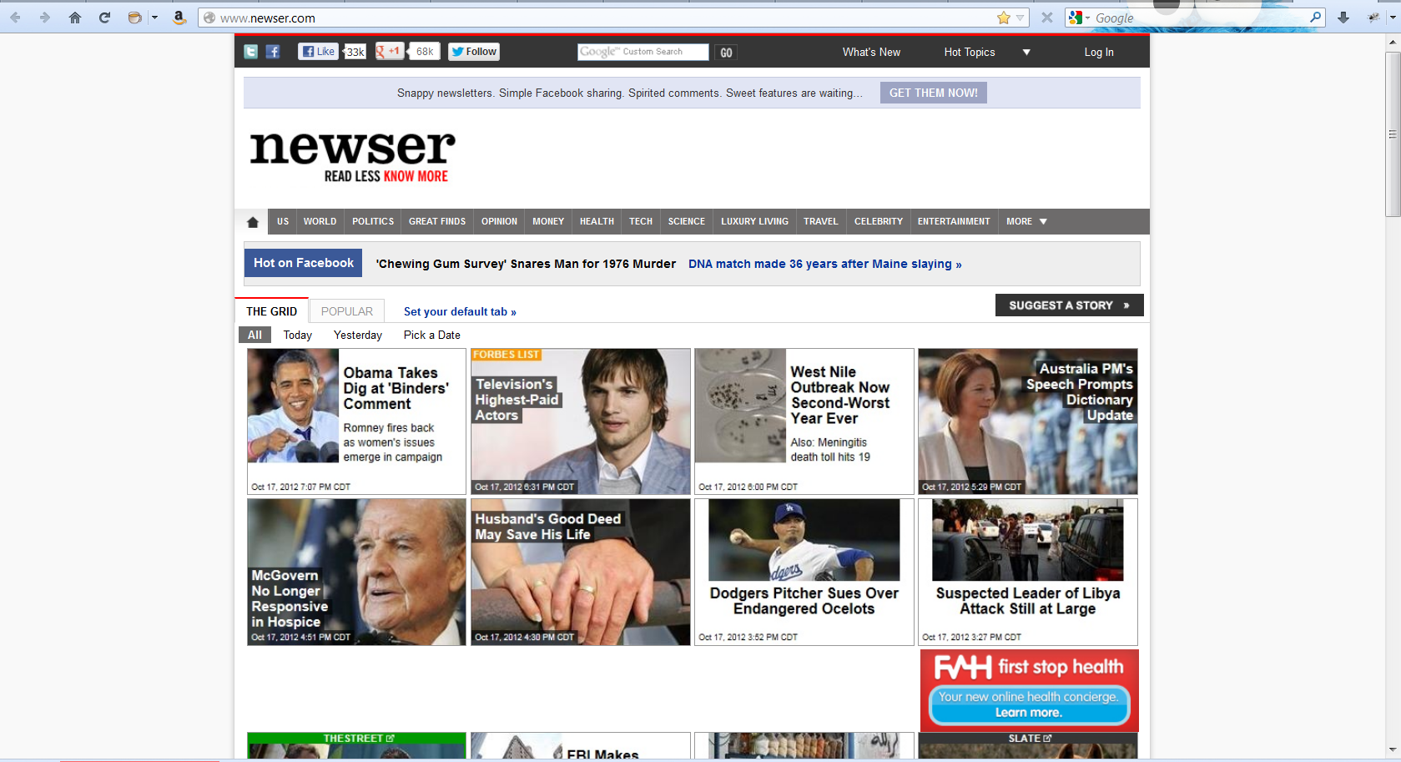
Separate Mobile Sites
Newser.com, on a desktop browser

Slide 11
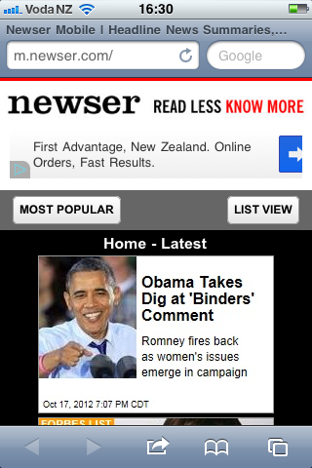

Separate Mobile Sites
Newser.com, given as the URL to Safari on an iPhone, automatically redirects to m.newser.com

Slide 12
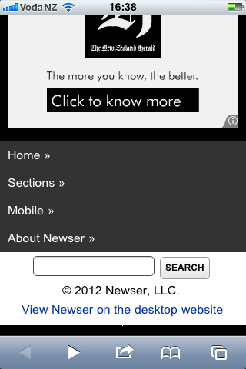
Separate Mobile Sites
The navigation, which was at the top on the desktop site is on the bottom here
You can also see a link to the full website, which is common practice in these dual-site architectures.
Two reasons:
Some users might want to view the full site (with zooming and scrolling you can usually get around a full site on a phone)
Some users might have been redirected to the mobile site by mistake (we’ll talk in a minute about how that could happen).

Slide 13
Implementation: Separate Mobile Sites
The process goes like this….
Sites are built
Server-side device detection
The server grabs incoming http requests and figures out who they come from
Server delivers appropriate page
You get either the regular page or the mobile page.

Slide 14
Server Side Device Detection
User-Agent Header Sniffing

Slide 15
Server Side Device Detection
We’re not going to worry too much about server side detection, because it’s a sys admin issue, not a developer issue, but it does have some impact on the whole “one-web/two-webs” argument
Web browsers send a User-Agent header as part of the HTTP request whenever the browser sends a request for a web page or resource
The User-Agent header contains information about the browser, including kind, version, and so forth
Hard to understand? Yes.
Reliable syntax? No.
Changes every time a new browser version is released? Yes.
Different formats used by all of the 1000s of device x OS x browser combinations in the world? Yes.
In practice, UA headers are so complex and changing so rapidly that your sys admin doesn’t handle it themselves, they use a remote service to do it.
The most common is called WURFL (Wireless Universal Resource FiLe), you can take a look at it if you want the under-the-hood details.
The point is, though, that UA sniffing isn’t fool proof. And that’s when the device isn’t lying.
It is not very difficult to get your browser to send a false UA header
And this is a big argument against the special mobile website. You can’t reliably detect what kind of device is making the request, so how can you reliably serve the correct page?

Slide 16
UA Sniffing
Important: It's worth re-iterating: it's very rarely a good idea to use user agent sniffing. You can almost always find a better, more broadly compatible way to solve your problem!
mozilla.org
Despite the claims of its detractors, browser sniffing is extremely reliable and accurate, with good solutions typically reporting in excess of 99.5% accuracy in detecting devices in the wild.
Mobiforge.com

Slide 17
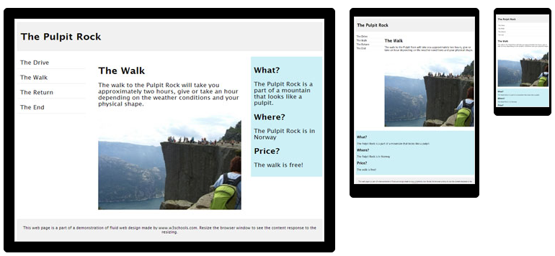
Responsive Web Design
Responsive web design (RWD) is an approach to web design aimed at crafting sites to provide an optimal viewing and interaction experience—easy reading and navigation with a minimum of resizing, panning, and scrolling—across a wide range of devices (from desktop computer monitors to mobile phones).

Slide 18
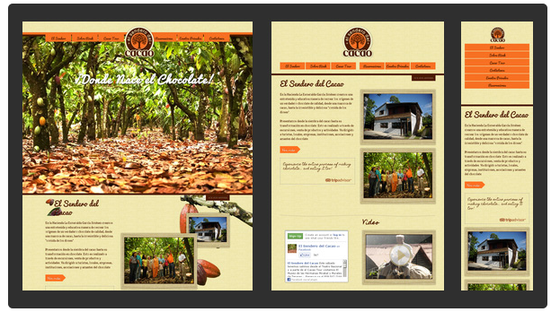
Responsive Web Design

Slide 19
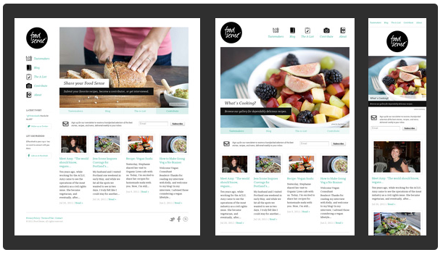
Responsive Web Design

Slide 20
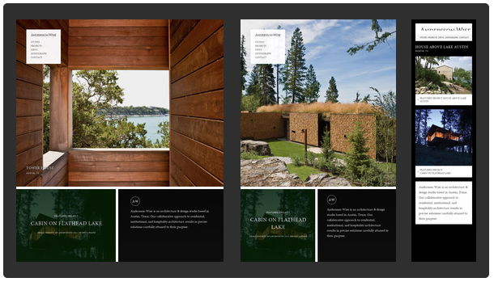
Responsive Web Design
http://www.anderssonwise.com/

Slide 21
Note about responsive web design
Note: A responsive site changes its layout as the size of the browser window changes (it can change based on other properties as well, but in practice, it is the size – particularly the width – of the browser window that is the critical property).
To test how your site really works on mobile, you should look at it on mobile. But during development, you can see the effects simply be resizing the browser.
However, you need to be a little careful about putting too much faith in this method.

Slide 22
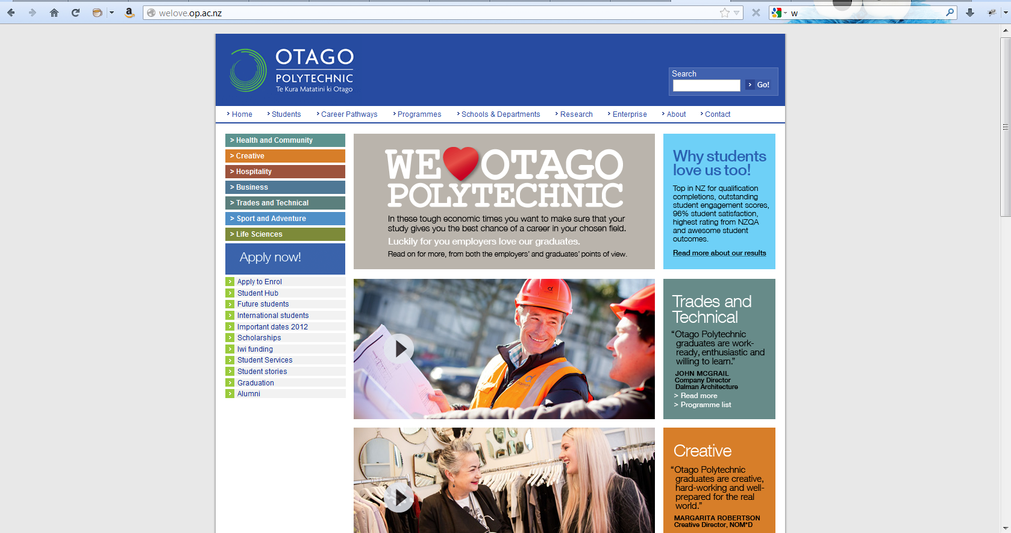
Evolution of OP Website

Slide 23


Evolution of OP Website
And here it is with the browser window resized to 320 x 480 (the screen dimensions of an iPhone).
You can see that it is certainly not responsive. The page clearly uses a fixed size wrapper (probably 960 px) and, when the screen gets small, all that happens is you see less of the 960 px, and you get a horizontal scroll bar (never acceptable).
But here’s what it looks like on an actual iPhone. You get the whole 960 pixels just squeeeeezed into 320. Much too small to read, so you pinch and zoom and scroll.
This is because the iPhone, and some other modern smart phones, *pretend* to be full size browsers. Rather than admit “I am 320 pixels wide” they say “I am going to pretend to be 960 pixels wide, but those are going to be really small pixels.”
We will see how to set up your pages so as to make the iPhone stop doing this, and actually act like a 320 pixel window.

Slide 24



Evolution of OP Website

Slide 25
Implementation: RWD
Three core techniques:
Media queries
Fluid grids
Fluid media

Slide 26
Implementation: RWD
Media Queries
Allows “conditional CSS”
Logically:
If screen is at least x pixels wide
Do this CSS
If screen is less than x pixels wide
Do this other CSS

Slide 27
Media Queries
More commonly the structure is like this, with the default being the smallest screen.
The default is common to all screens,
the special CSS overrides
Note that the cascade applies, so the “other CSS” will override the default CSS where necessary.
Whether you go up or down with your conditionals (i.e. your default is for the small screen or for the large) is an element of a major design philosophy schism we will discuss in a moment.
Do this default CSS
If screen is between x and y pixels wide
Do this other CSS
If the screen is more than y pixels wide
Do this other CSS

Slide 28
Media Queries
The CSS is applied only if the media query evaluates to true
@media mediaType and mediaFeatures
{
conditional CSS rules
}
MediaType can be screen, print, braille, tty, and a number of others, but for our purposes, we are interested in ‘screen’
There are a variety of media features, and an assortment of conditional operators.

Slide 29
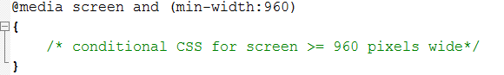
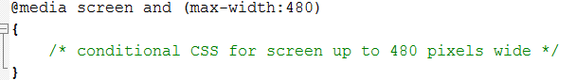
Media Queries
Syntax
Note the syntax: use a ‘:’ not an ‘=‘
Min-width = “at least as wide as”
Max-width = “no wider than”
Note that these are not properties of the device, they are the current width of the browser window.

Slide 30
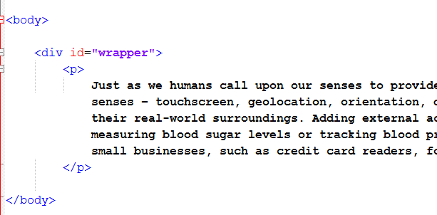
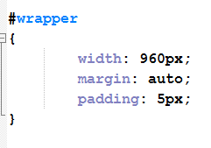
Media Queries
Ordinary html….
Ordinary css…

Slide 31
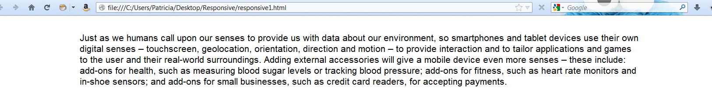
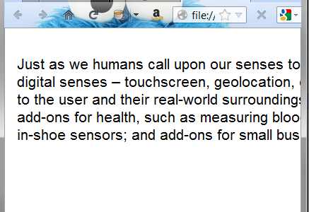
Media Queries
Ordinary web page…
If we resize the browser to simulate a smaller screen, the page looks like this….
Specifically, the text is cut off. The div remains at 960 pixels wide, even though the window is not that wide. It’s not shown in this picture, but you get a horizontal scroll bar at the bottom of the screen, which is hateful.
Now try adding a media query to your css…

Slide 32
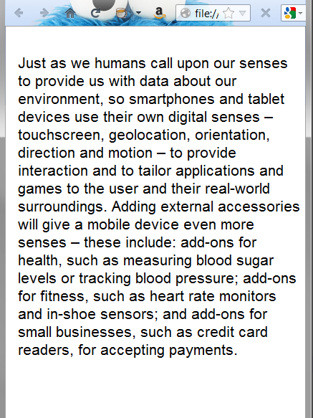
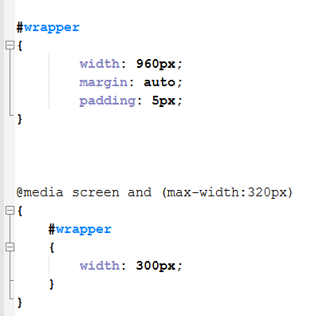
Media Queries
Note that we only define those CSS rules we want to override.
Now when we make the window small, the div width becomes small as well

Slide 33
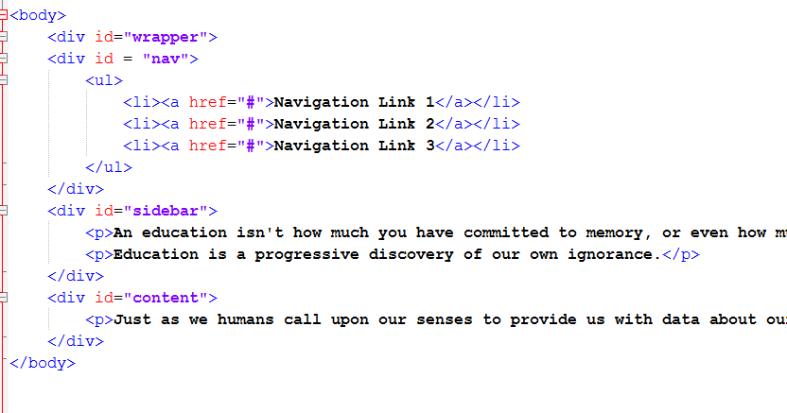
Media Queries

Slide 34
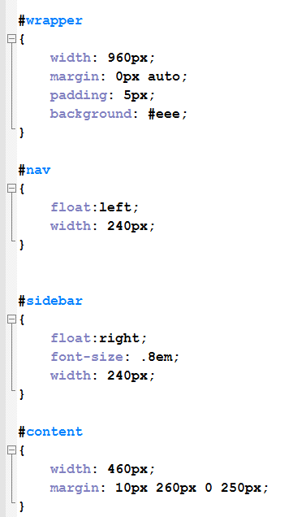
Media Queries
Vanilla CSS…
Float the nav to the left and the sidebar to the right.
Position the center column by setting its margins (there are other ways to do this, of course, but this is a common technique)

Slide 35
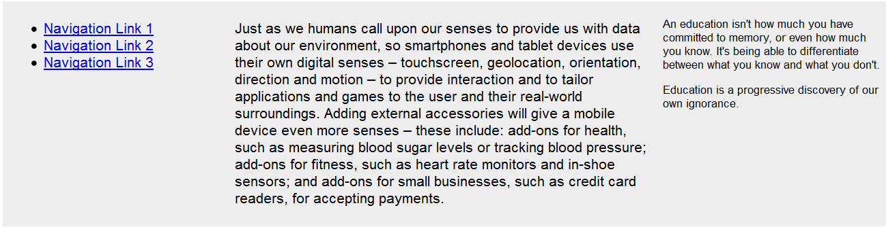
Vanilla webpage

Slide 36
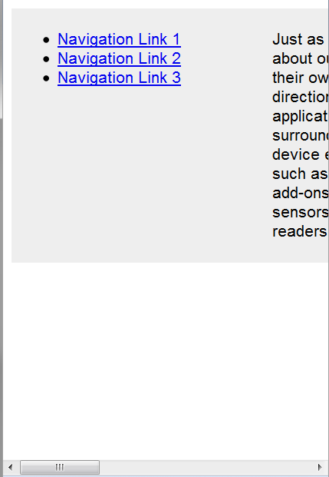
When resized:
So how would you fix this for a small screen?
You need to do two things:
Quit having everything be 960
Put everything in one column

Slide 37
Media Queries
Notes:
So let’s resize those pixel widths and get rid of the floats and clear the margins that are controlling the content placement.

Slide 38
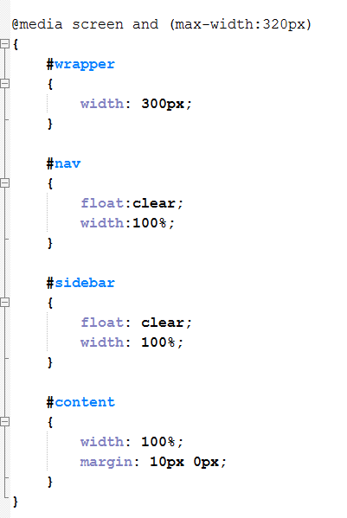
Media Queries
Here’s the CSS to override the default styles that we want to change.
Different widths and clear the floats
Note that, in addition to clearing the floats and margins we are using width:100%
This is another important piece of RWD we’ll talk more about later.
The logic is, if you don’t know how big the screen is going to be, don’t give an absolute size.
Think in terms of “fill the whole width” or “fill 1/3 or the width”, etc.
It is important to note that, in CSS, %age widths are determined relative to the containing element in the DOM not relative to the window.
Some more example in a moment.
Now at full-screen, our page looks exactly the same. But at 320….

Slide 39
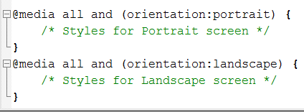
Media queries for Device orientation

Slide 40
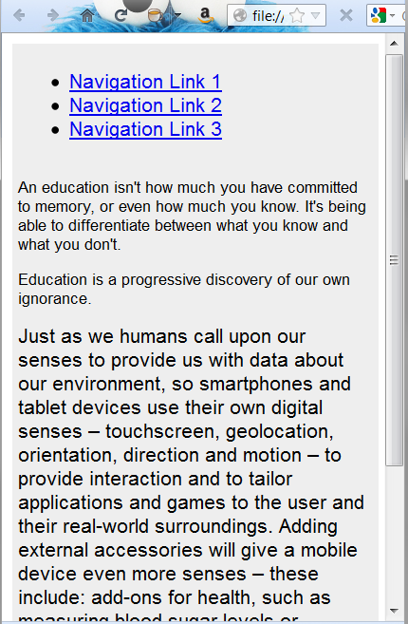
Media Queries
You can see it change abruptly as you resize the browser window.
The point at which it changes is called a “breakpoint”.
In this example, we have one breakpoint at 320 px.
Note that you can have as many media query blocks and thus as many breakpoints as you want.
By using different values of min-width and max-width, you can target all the specific device sizes you care about, for example: phone, iPad, desktop.
We’ll talk about breakpoints some more in just a minute….

Slide 41
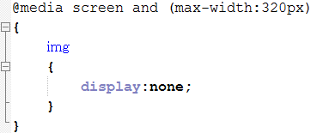
Media Queries
Making elements disappear
Set display:none
Using this technique you can provide lots of contents when the browser is big and not have to worry about it cluttering things up when the browser is small.
Any problems with this that you can think of? =>Display:none hides content, it doesn’t remove it
Thus content that’s in the default html & CSS (so not including images assigned via background url) is downloaded to the browser whether it’s hidden or not.
One of the big issues around web for mobile is reduced bandwidth and slow download times, so this is a problem.
Solutions? => Make the mobile content the default, and add with media queries for larger screens.

Slide 42
Demo
http://liveweave.com/urzBsf

Slide 43
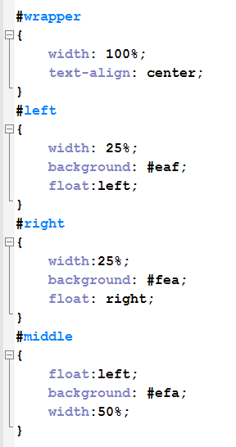
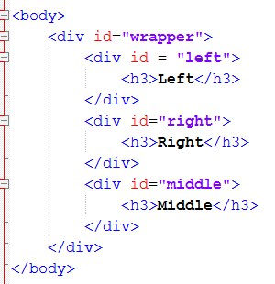
Fluid Grids
Specify element widths as percentages of their containing element
The second cornerstone of RWD

Slide 44
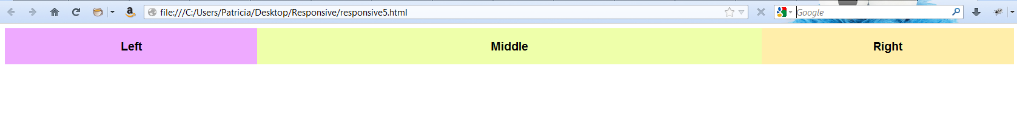
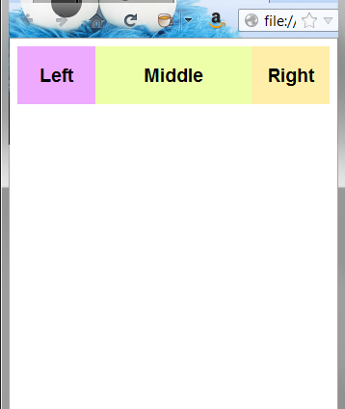
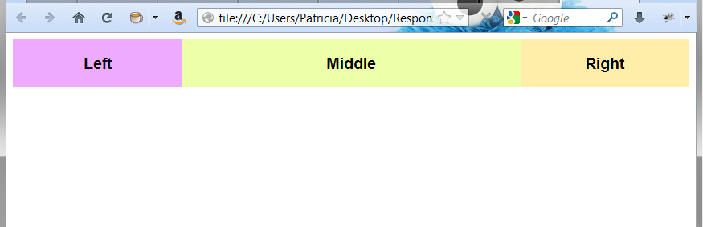
Fluid Grids
NO media queries here, just the divs resizing themselves to a percentage of the containing element.
There are complexities with dealing with the content and allowing for borders, margins and paddings, but this is the basic idea.

Slide 45
Demo
http://liveweave.com/ETEPRe

Slide 46
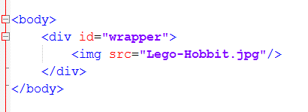
Fluid Media
A very different problem from layout.
Still experimental for embedded video, applets, etc.
As it turns out, at least for images, the whole resizing thing is straightforward
Here is some normal html, we look at the page as we shrink the browser window…

Slide 47
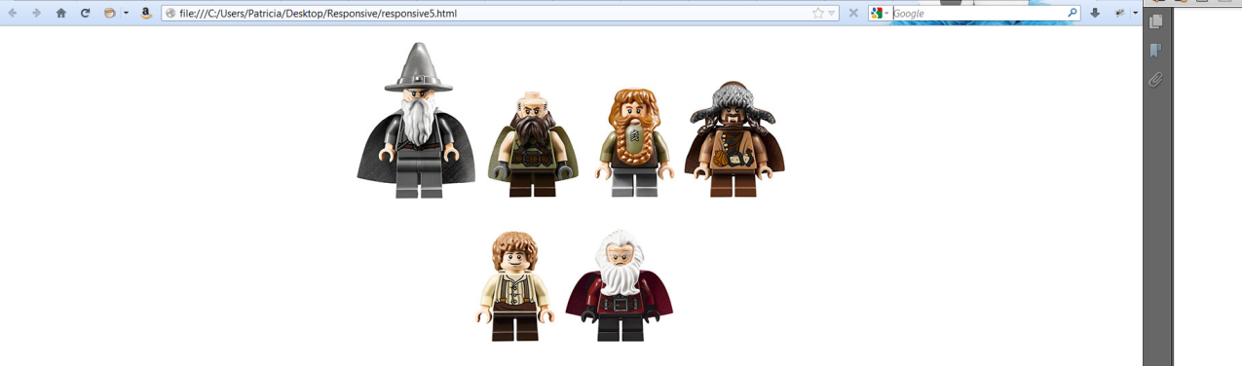
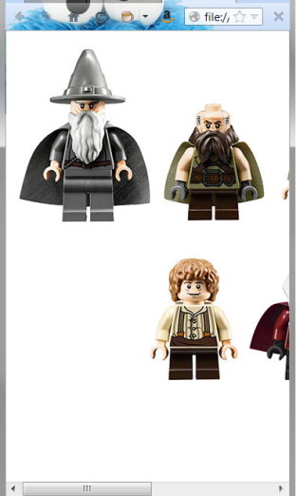
Fluid Media
the image just gets cut off.

Slide 48
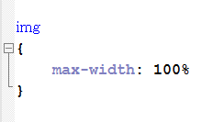
Fluid Media

Slide 49
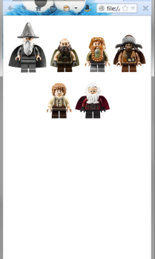
Fluid Media
Your images will resize to 100% of their containing element.
And that’s pretty much responsive design.
Don’t be fooled though: while the concepts seem easy -- use conditional CSS to accommodate different screen sizes – the implementation is anything but easy.
Here’s just one of the problems….

Slide 50
Demo
http://liveweave.com/VoRzZA

Slide 51
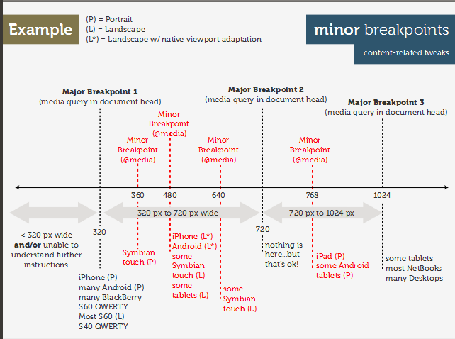
Breakpoints
http://www.netmagazine.com/tutorials/determining-breakpoints-responsive-design

Slide 52
Breakpoints
Just one of the complexities of RWD.
Essentially you are being asked to write cascading CSS for all the important breakpoints
The general suggestion is to serve different physical style sheets at the major breakpoints (done by using media queries in the <link>) and using embedded media queries for the minor break points.
You end up writing a lot of CSS. So if you thought the advantage of RWD over dedicated mobile sites was having to write less CSS, that was wrong.

Slide 53
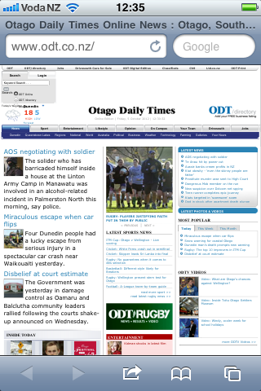
Making the iPhone Behave
This is what the ODT looks like on iPhone. It squishes down really, really tiny.
This happens because Safari on iOS pretends to be 960 pixels wide. When fully zoomed out (i.e. normal), it makes teeny tiny pixels.
The logic is that users will want to get the full site, and are willing to zoom and pinch to read and navigate.
If you have written a responsive site, you want the browser not to do this. You want it to say it’s 320 pixels when it is.
To enforce this behaviour, you simply add a line to the <head> section of your website.

Slide 54
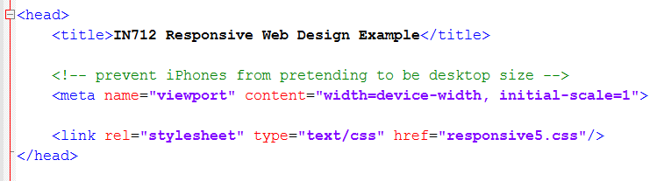
Making the iPhone Behave
That <meta> tag there. It sets properties of the viewport, which is the browser’s visible area.
It sets width=device-width so that the browser admits to being its real size, not the iPhone’s pretend size.

Slide 55
Two different design philosophies
Graceful Degradation
Progressive Enhancement
Full desktop is default
If reduced features detected
Degrade content
Eliminate or simplify functionality
Minimal browser is default
If enhanced features detected
Upgrade content
Add functionality

Slide 56
Full desktop is default
If using media queries, you might hide elements with display:none, or swap in smaller images for background-image
If using js feature detection, this is where you’d have “your browser doesn’t support the canvas element” or equivalent.
This approach is called “graceful degradation”, and it has been the standard for some time. That whole “you are missing plug-ins” thing is GD. Alt tags in <img> elements are a kind of GD.
GD primarily was about giving some kind of nod to old browsers as browser technology improved so fast.

Slide 57
Minimal browser is default
If you detect a big browser, swap in bigger pictures
Use your js to add in HTML5 graphics when you detect the <canvas>, but if it’s not detected, have something in place that works (perhaps some text-based solution). Nobody every sees “you are missing some content because of your hardware”.
This approach is called “progressive enhancement”, and it is rapidly gaining favour as the better technique for the modern web environment where we want to make all devices equal players, rather than think only current/obsolete browser.
Better UX for more people
Better SEO
Forces a lean design (fights “feature bloat”)
Reduces bandwidth waste

Slide 58
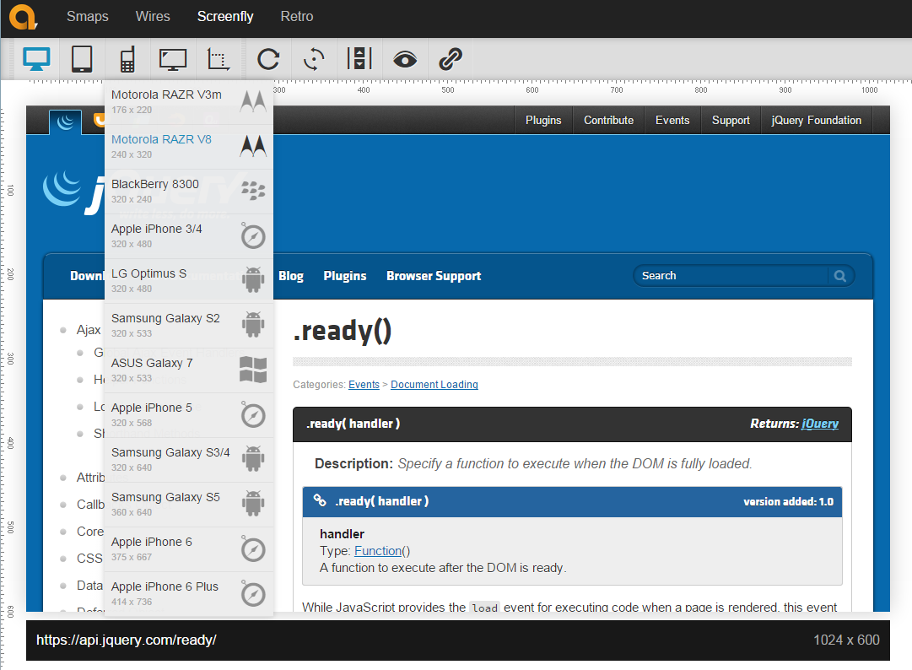
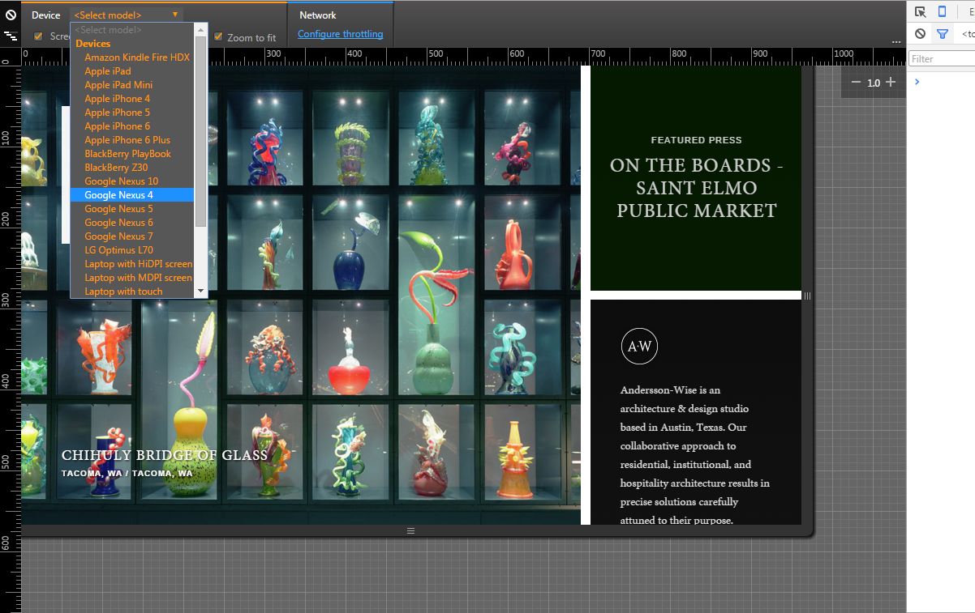
Useful Tools to Test RWD
Dev tools in Chrome
Ctrl+Shift+j
http://quirktools.com/screenfly/

Slide 59
Great Examples of RWD
http://www.anderssonwise.com/
http://stephencaver.com/
http://seesparkbox.com/
http://foodsense.is/
http://www.bostonglobe.com/
http://forefathersgroup.com/
http://spigotdesign.com/
http://ribot.co.uk/
http://www.authenticjobs.com/
http://www.cacaotour.com/index.php/en/home
http://www.stpaulsschool.org.uk/

